Slide 1

AI-Powered Meeting Assistant

Slide 2
GenAI-Driven Procurement Price Benchmarking
This document outlines the Proof of Concept (PoC) design for a GenAI-powered Procurement Price Benchmarking Agent.
The Procurement which is envisaged as per this BRD is branched into smaller pointed solutions which can be designed and developed and then integrated to ERP collectively as an AI enabled automation solution at enterprise level.
The details mentioned here are not to be deemed as solution. These are just a high-level assumption-based point of views.
Process particularization, pain point/ business challenge detailing along with data pointers has to be done by Wockhardt team (during expected workshop).
Clarity of Data Aspects (from ERP like SAP) and Integration aspects (External APIs, and ERPs) has to be provided by Wockhardt

Slide 3
PoC Objectives: Enhancing Procurement Efficiency
Objective/Task | Description | Scope for Hypothesis
Map and standardize SKUs | Eliminate ambiguity and hallucination by ensuring SKU consistency. | Yes One Sample SKU like ‘Paracetamol’
Develop and fine-tune a GenAI model | Use historical pricing, market indicators, vendor data, and contract terms to train the model. | Using existing GenAI model (along with ML/DL Algos). No Finetuning of LLMs for hypothesis
Integrate with ERP/procurement platforms | Enable seamless operational workflows across procurement systems. | No Workflow automation, Sample/Mock Data will be used
Provide real-time, contextual price comparisons and recommendations | Deliver insights based on current data and pricing trends. | Sample Prices would be used
Detect market volatility early | Trigger proactive decision support through early detection mechanisms. | NA for Hypothesis, AI-generated procurement guidance
Improve procurement decision-making | Enhance speed, accuracy, and strategic quality of purchasing decisions. | Generate Mock Procurement Price Recommendation
Notes:
.dft (draft), .asm (assembly), and .cfg (configuration)

Slide 4
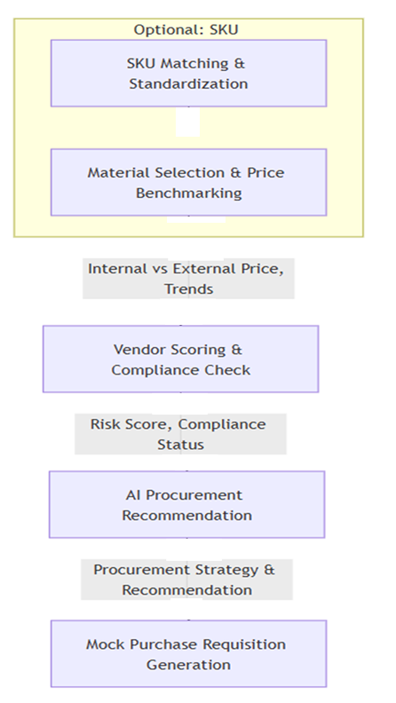
Procurement – Use Case Work-Break Down – for PoC
AI/ ML /DL Use Cases
SKU Matching & Standardization ➔ SKU mapping and normalization (this is MDM use case, could be done through AI only if MDM is not there)
Material Selection & Price Benchmarking ➔ Inputs: Mock internal procurement data + external market prices ➔ Output Examples: Current vs. market price comparison, price trends
Vendor Scoring & Compliance Check ➔ Inputs: Pricing Comparison & Vendor compliance data ➔ Output Examples: Vendor risk score & qualification status
Automation (coupled with Gen-AI) Use Cases
Risk Score, Compliance ➔ Status Report
Procurement Recommendation & Negotiation ➔ Inputs: Price comparison & Trends ➔ Output Examples: AI-generated narrative on when/how/where to buy
Mock PR Generation ➔ Inputs: Material, price recommendation, vendor selection ➔ Output Examples: Pre-filled PR template in UI
Notes:
.dft (draft), .asm (assembly), and .cfg (configuration)

Slide 5
Procurement – Use Case Work-Break Down for PoC
Continued…
Step | Action / Feature | Purpose
SKU Matching & Suggestion (Optional but valuable) | System suggests similar materials to avoid duplicate SKUs or improper item selection | - Harmonize material master data and prevent duplication or mismatched items
Material Selection & Price Benchmarking | User selects API/Excipient/Packaging Material → system displays current internal vs. external price with trends | - Forecast short-term price trends- Predict likely price- Highlight unusual spikes or savings opportunities
Vendor Scoring & Compliance Display | System shows vendor risk score and qualification with traffic light indicators (Low, Medium, High Risk) | - Calculate vendor risk tier based on compliance, audit status, and historic reliability
Procurement Recommendation & Negotiation | System generates a recommendation (buy now, delay, switch vendor, negotiate) based on price, risk, Vendor Score and compliance | - Generate narrative recommendations blending price, supplier, and risk intelligence
Mock Purchase Requisition Generation | System auto-fills a Purchase Requisition based on AI recommendation and allows user to review in UI | - Demonstrate potential for automated PR creation and ERP integration

Slide 6
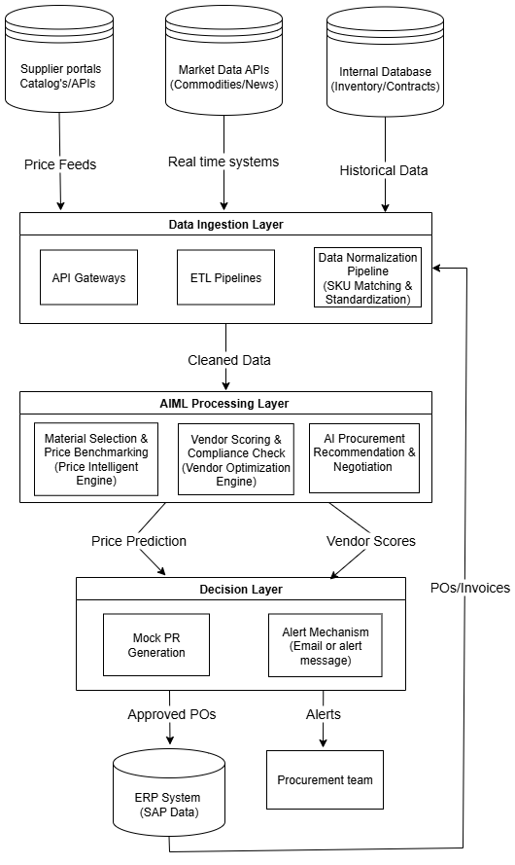
Tentative Gen-AI Enabled Procurement Automation
Architecture

Slide 7
Questionnaire for Clarification on Procurement
Requirements
Queries for Procurement (Wockhardt)

Slide 8



Thank You
www.elementtechnologies.com
info@elementtechnologies.com
Element Infomatics (India) Pvt. Ltd.
Axis Pennmark, # 565, 1st Floor ,
9th Cross Rd, 3rd Phase, J.P. Nagar,
Bengaluru – 560078, Karnataka, India
Element Technologies Inc.
1100 Cornwall Rd, Suite 113 Monmouth Junction, NJ 08852
USA

